Slide 1
The Finite Element Method Defined
The Finite Element Method (FEM) is a weighted residual method that uses compactly-supported basis functions.

Slide 2
Brief Comparison with Other Methods
Finite Difference (FD) Method:
FD approximates an operator (e.g., the derivative) and solves a problem on a set of points (the grid)
Finite Element (FE) Method:
FE uses exact operators but approximates the solution basis functions. Also, FE solves a problem on the interiors of grid cells (and optionally on the gridpoints as well).

Slide 3
Brief Comparison with Other Methods
Spectral Methods:
Spectral methods use global basis functions to approximate a solution across the entire domain.
Finite Element (FE) Method:
FE methods use compact basis functions to approximate a solution on individual elements.

Slide 4
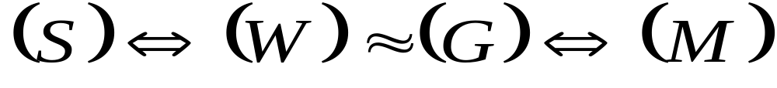
Overview of the Finite Element Method
Strong
form
Weak
form
Galerkin
approx.
Matrix
form

Slide 5
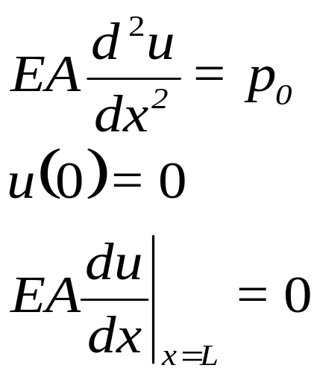


Sample Problem
Axial deformation of a bar subjected to a uniform load
(1-D Poisson equation)
L
u = axial displacement
E=Young’s modulus = 1
A=Cross-sectional area = 1

Slide 6
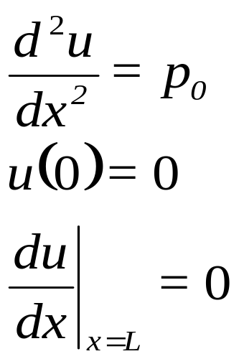
Strong Form
The set of governing PDE’s, with boundary conditions, is called the “strong form” of the problem.
Hence, our strong form is (Poisson equation in 1-D):

Slide 7
Weak Form
We now reformulate the problem into the weak form.
The weak form is a variational statement of the problem in which we integrate against a test function. The choice of test function is up to us.
This has the effect of relaxing the problem; instead of finding an exact solution everywhere, we are finding a solution that satisfies the strong form on average over the domain.

Slide 8
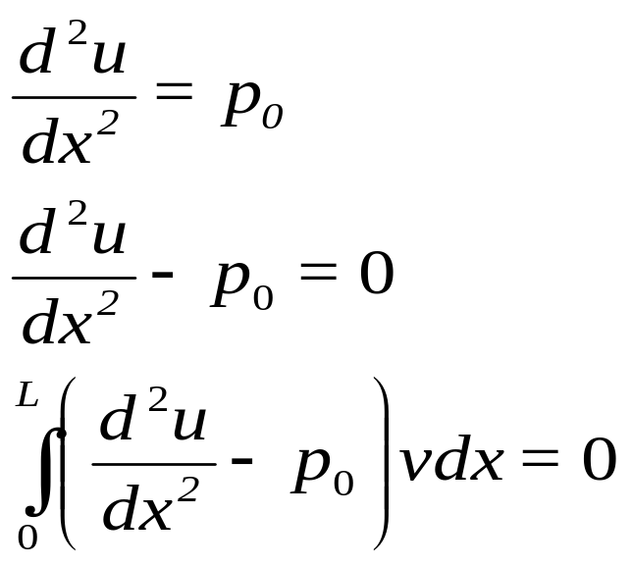
Weak Form
Strong Form
Residual R=0
Weak Form
v is our test function
We will choose the test function later.

Slide 9
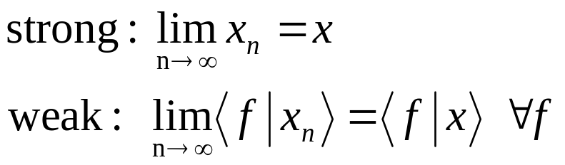
Weak Form
Why is it “weak”?
It is a weaker statement of the problem.
A solution of the strong form will also satisfy the weak form, but not vice versa.
Analogous to “weak” and “strong” convergence:

Slide 10
Weak Form
Choosing the test function:
We can choose any v we want, so let's choose v such that it satisfies homogeneous boundary conditions wherever the actual solution satisfies Dirichlet boundary conditions. We’ll see why this helps us, and later will do it with more mathematical rigor.
So in our example, u(0)=0 so let v(0)=0.

Slide 11
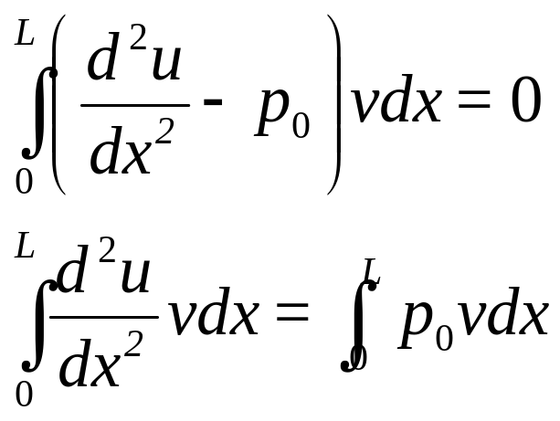
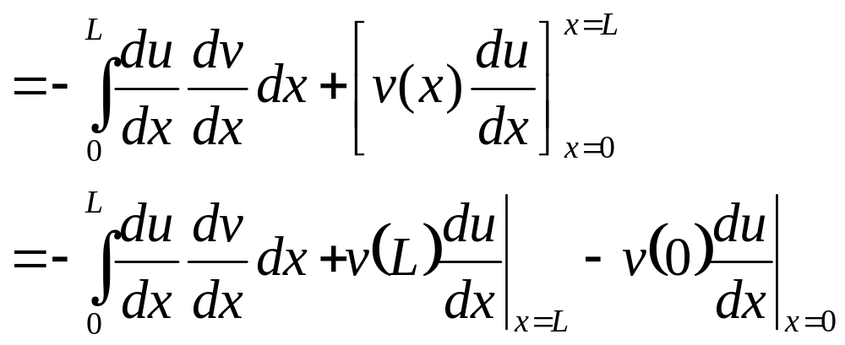
Weak Form
Returning to the weak form:
Integrate LHS by parts:
Integrate

Slide 12
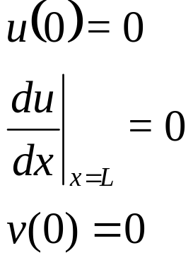
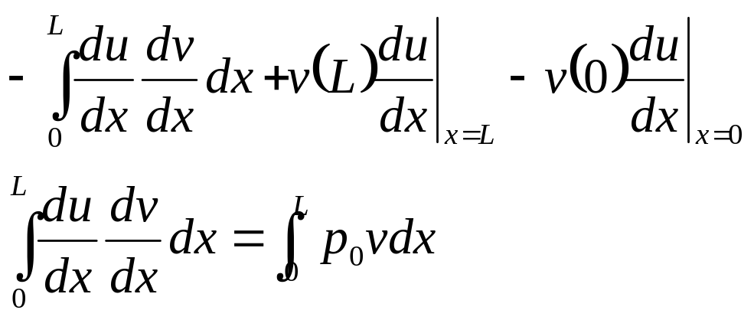
Weak Form
Recall the boundary conditions on u and v:
Hence,
H
The weak form satisfies Neumann conditions automatically!

Slide 13
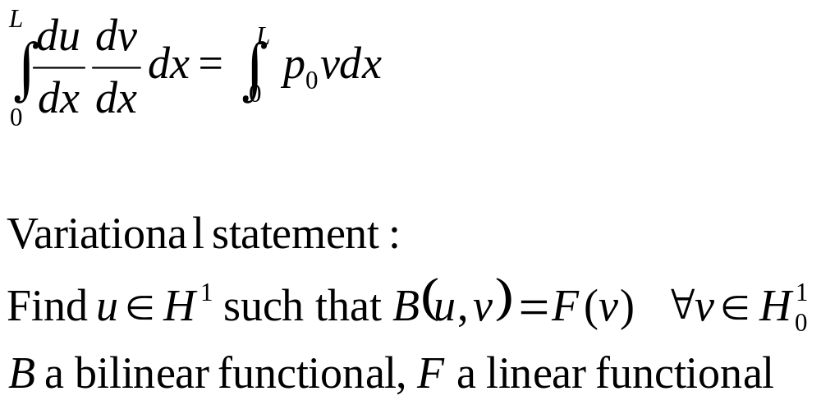
Weak Form
Why is it “variational”?
u and v are functions from an infinite-dimensional function space H

Slide 14
Galerkin’s Method
We still haven’t done the “finite element method” yet, we have just restated the problem in the weak formulation.
So what makes it “finite elements”?
Solving the problem locally on elements
Finite-dimensional approximation to an infinite- dimensional space → Galerkin’s Method

Slide 15
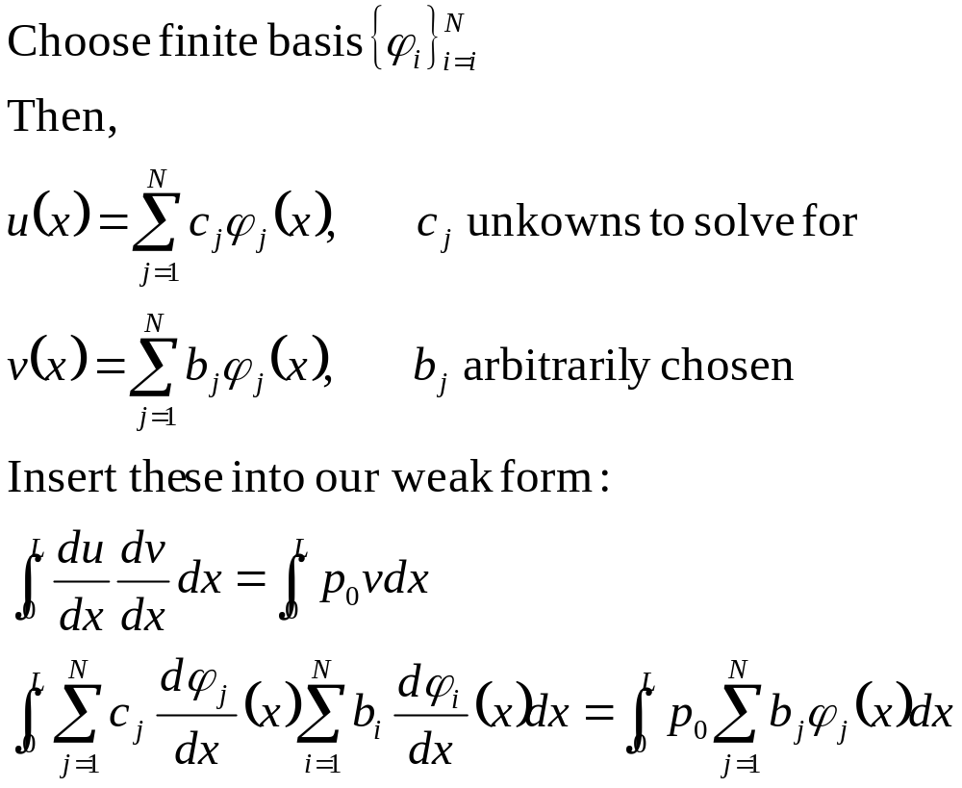
Galerkin’s Method

Slide 16
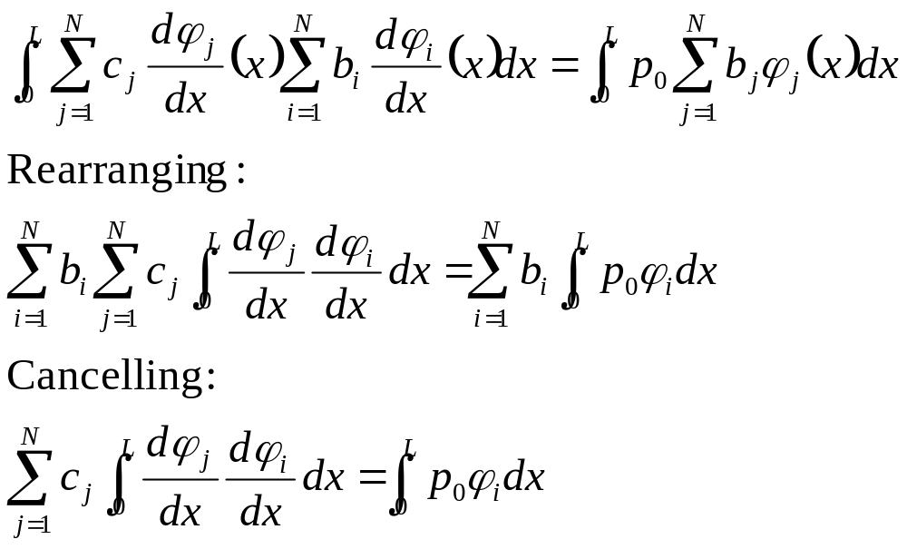
Galerkin’s Method

Slide 17
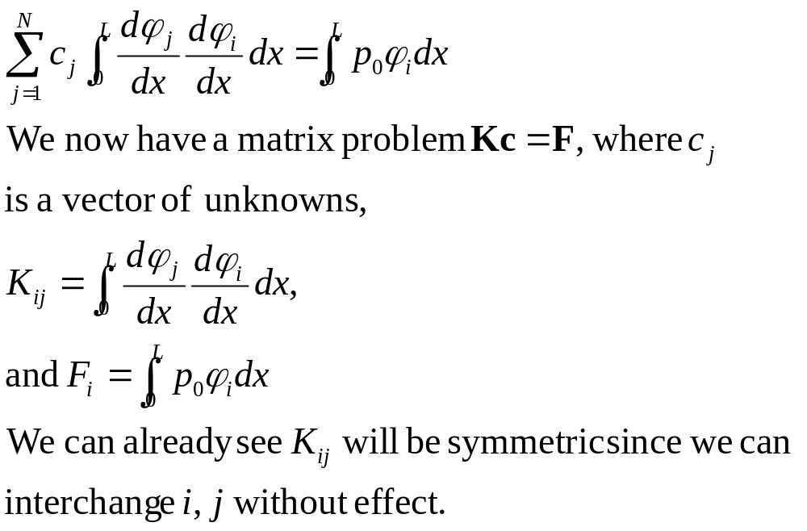
Galerkin’s Method

Slide 18
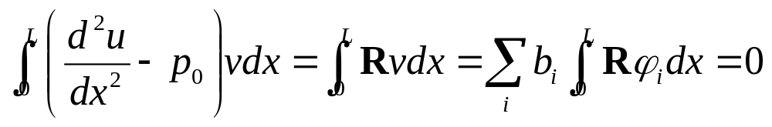
Galerkin’s Method
So what have we done so far?
1) Reformulated the problem in the weak form.
2) Chosen a finite-dimensional approximation to the solution.
Recall weak form written in terms of residual:
This is an L₂ inner-product. Therefore, the residual is orthogonal to our space of basis functions. “Orthogonality Condition”

Slide 19
Orthogonality Condition
The residual is orthogonal to our space of basis functions:
u
H
H^{h}
u^{h}
φ_{i}
Therefore, given some space of approximate functions H^{h}, we are finding u^{h} that is closest (as measured by the L₂ inner product) to the actual solution u.

Slide 20
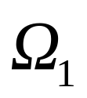
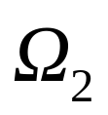
Discretization and Basis Functions
Let’s continue with our sample problem. Now we discretize our domain. For this example, we will discretize x=[0, L] into 2 “elements”.
0
h
2h=L
In 1-D, elements are segments. In 2-D, they are triangles, tetrads, etc. In 3-D, they are solids, such as tetrahedra. We will solve the Galerkin problem on each element.

Slide 21
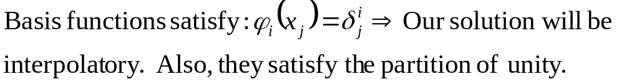
Discretization and Basis Functions
For a set of basis functions, we can choose anything. For simplicity here, we choose piecewise linear “hat functions”.
Our solution will be a linear combination of these functions.
φ₁
φ₂
φ₃
x₁=0
x₂=L/2
x₃=L

Slide 22
Discretization and Basis Functions
To save time, we can throw out φ₁ a priori because, since in this example u(0)=0, we know that the coefficent c₁ must be 0.
φ₂
φ₃
x₁=0
x₂=L/2
x₃=L

Slide 23
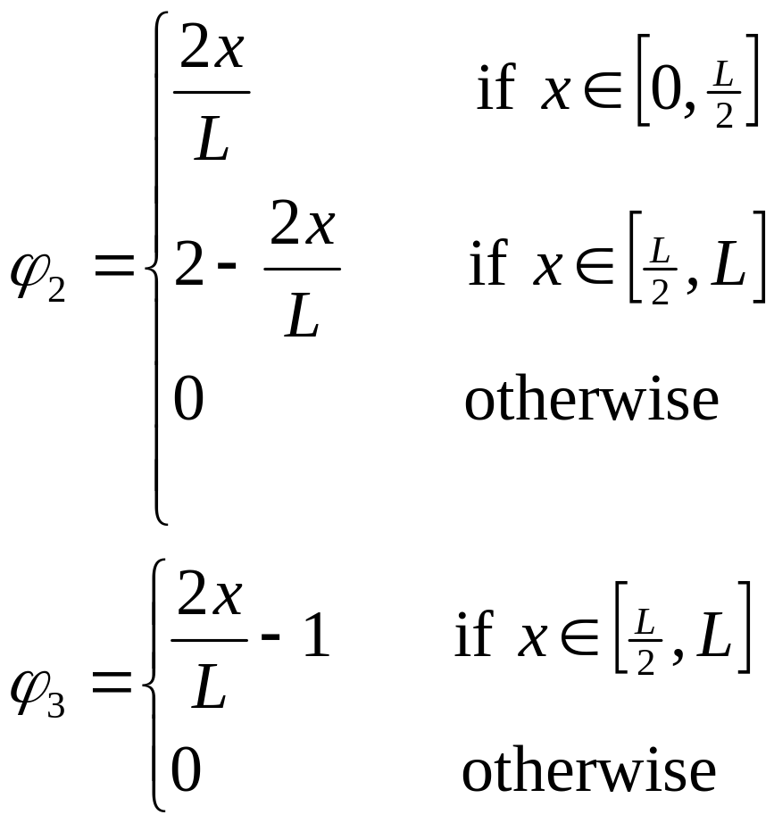
Basis Functions
φ₂
φ₃
x₁=0
x₂=L/2
x₃=L

Slide 24
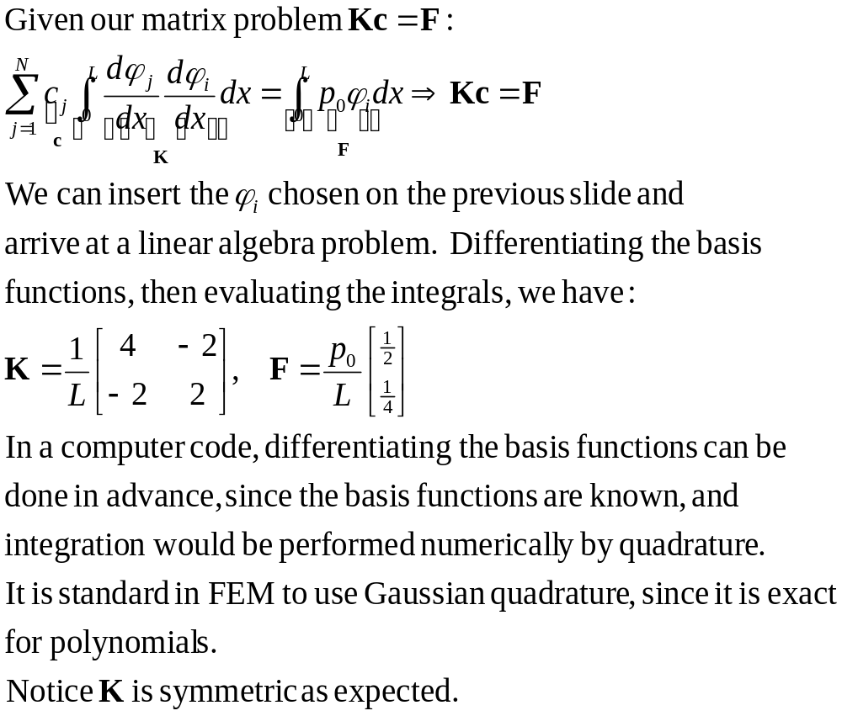
Matrix Formulation

Slide 25
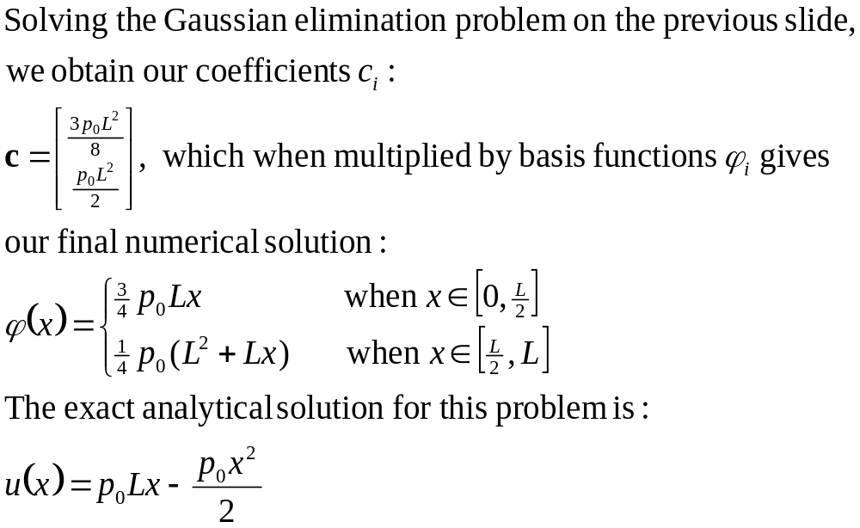
Solution

Slide 26
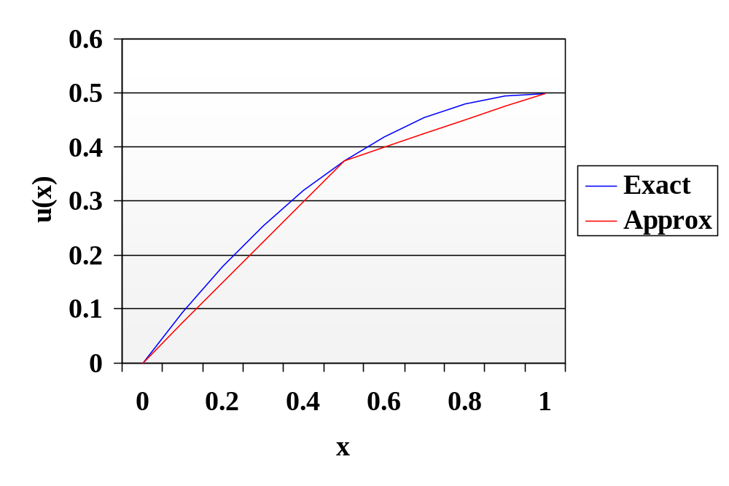
Solution
Notice the numerical solution is “interpolatory”, or nodally exact.

Slide 27
Concluding Remarks
Because basis functions are compact, matrix K is typically tridiagonal or otherwise sparse, which allows for fast solvers that take advantage of the structure (regular Gaussian elimination is O(N³), where N is number of elements!). Memory requirements are also reduced.
Continuity between elements not required. “Discontinuous Galerkin” Method

